Slide 1
Continuous Integration With Jenkins

Slide 2
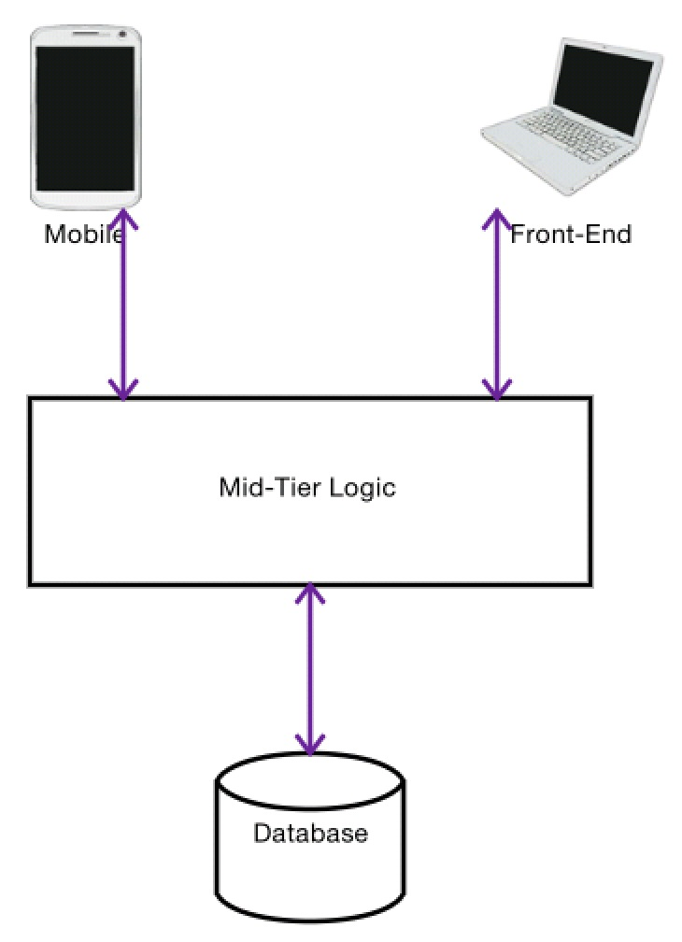
What is Continuous Integration ?

Slide 3
Jenkins Objectives
It is an open source CI tool
Continuous builds with Maven or Gradle
Run a shell script
Continuous deployments
Continuous testing
Archive the build results

Slide 4
What is in there?
Advantages and Features
Jenkins Setup and Configurations
Jenkins Management
Project Configuration
Running a project using Jenkins
Scheduling Jenkins to automate the process

